Slide 1
Comparison of 2015 and 2022 Questionnaire Responses

Slide 2
Number of responses
2015 | 2022
100 household responses covering 226 people | 107 household responses covering 224 people

Slide 3
Comparison of who lives in the village?
(% of respondents)

Slide 4
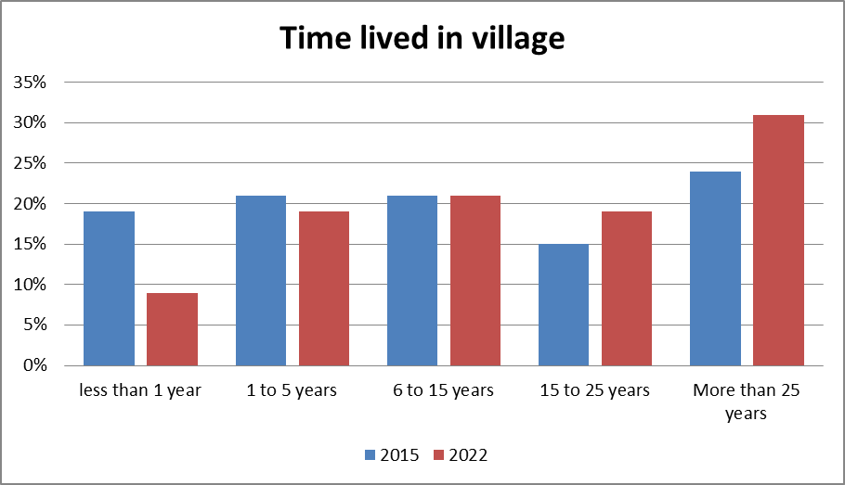
Comparison of how long people have lived in the village?

Slide 5
% Comparison of local facilities used:
%
%
Data as a percentage of responses:

Slide 6
Comparison of areas of concern:
(% of respondents)

